Slide 1



Reconstituting the Lung on a Chip
Jaimeson Veldhuizen
Mentors: Dr. Linan Jiang, Department of AME and OSC
Dr. Yitshak Zohar, Departments of AME and BME
University of Arizona
2017 Statewide Symposium for NASA Space Grant at ASU
April 21-22, 2017

Slide 2
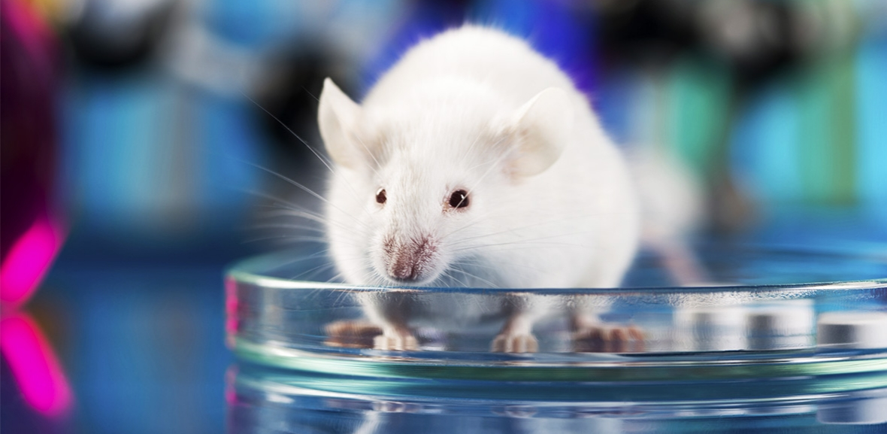
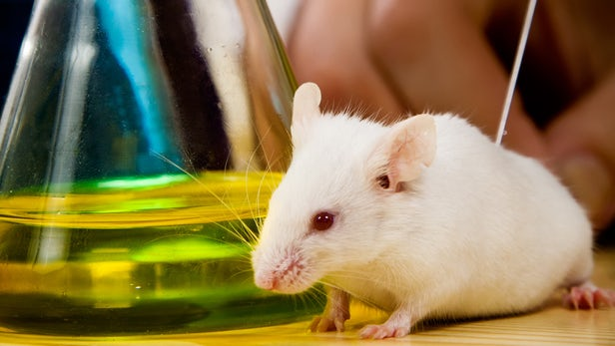
Background
Environmental insults and pathogens
Pharmaceutical testing
Preclinical and clinical testing
Preclinical testing costs in 2013: $1,098 Million
Source: slate.com
Source: newatlas.com

Slide 3
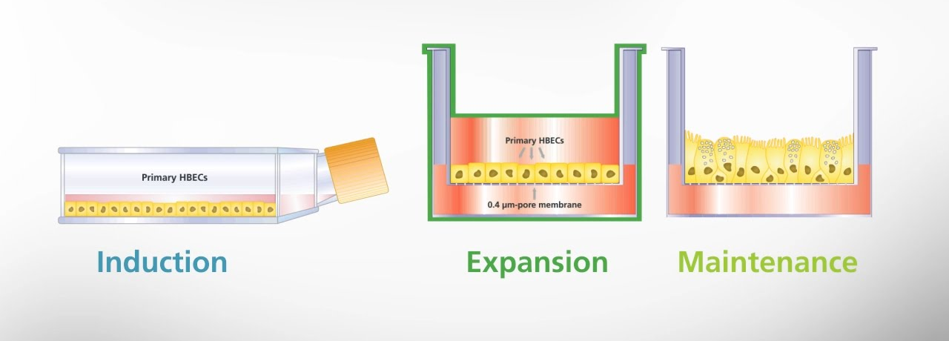
Motivation
Two approaches are available:
in vitro mono-layered cell culture (MCC) model
in vivo animal model
Source: stemcell.org
Source: slate.com
Advantages:
-mechanism defining
-use of human cells
-physiologically relevant
Disadvantages:
-lack of critical communication between different cell types
-human cells respond differently compared to animal cells
-92% of drugs that pass animal tests fail in human testing
Notes:
However:
MCC models, although being extremely useful in delineating cellular mechanisms, have been proven to be poor predictors of physiological responses. The lack of critical communications between different cell types in MCC models has been the major reason for this failure.

Slide 4
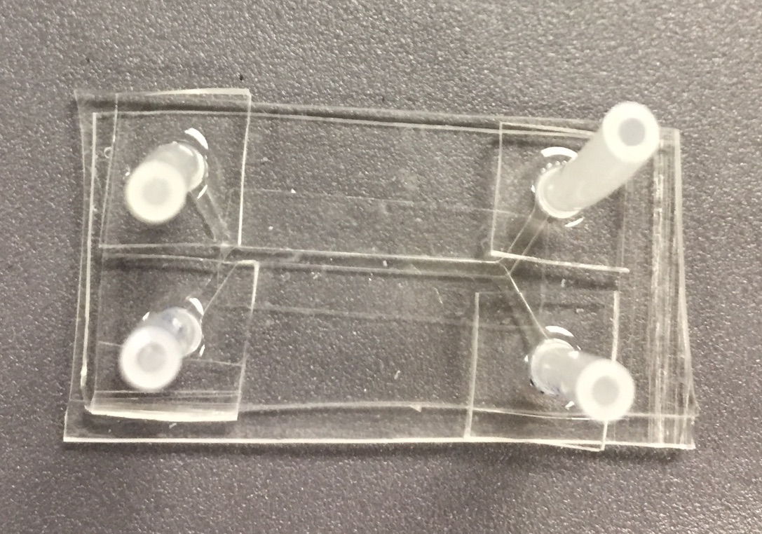
Objectives
Motivation
Develop an effective and high-throughput, yet low cost, system to overcome the deficiencies of the MCC and animal models
Device must be:
  Biocompatible
  Optically suited for imaging
  Designed to incorporate overlapping channels
  Micron-level to ensure microfluidic properties
Notes:
to build a novel microfluidic ex vivo lung model (MEVL) that features both airway and vascular channels with differentiated primary epithelial and endothelial cells as well as difefrent lineages of hematopoietic cells

Slide 5
Methods
Fabrication and preparation of microfluidic devices for bio application
Maintenance of epithelial and endothelial cells in culture dishes
Loading and establishing confluent cell monolayers in microfluidic devices

Slide 6
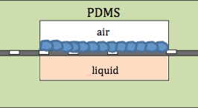
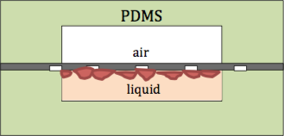
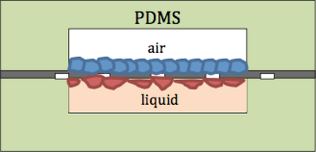
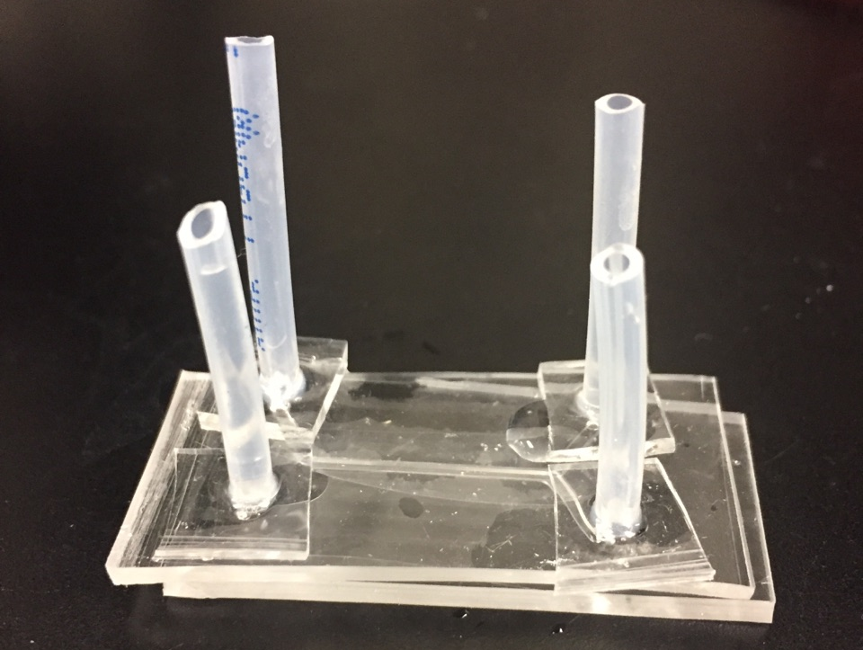
Methods
Epithelial cells (A549)
Endothelial cells (HUVEC)

Slide 7
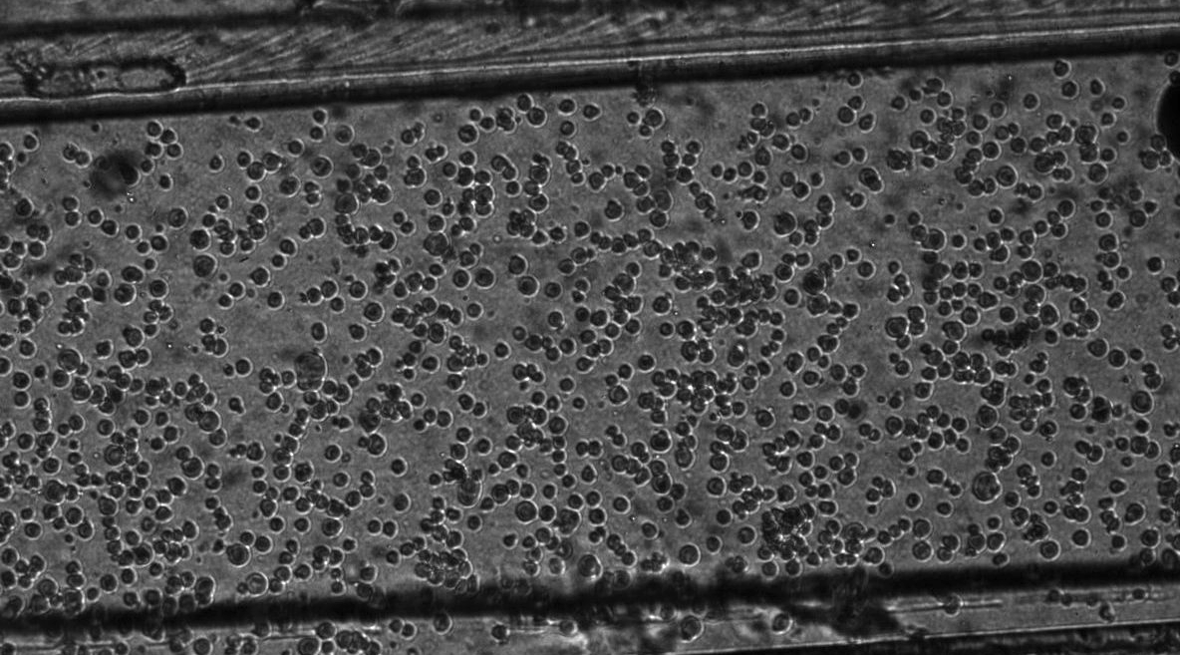
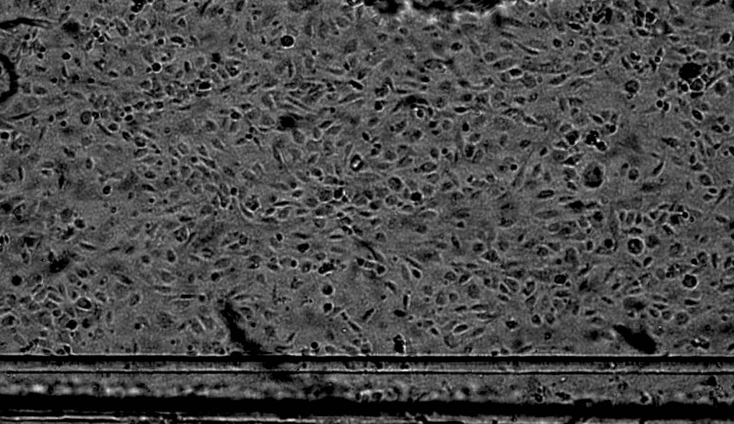
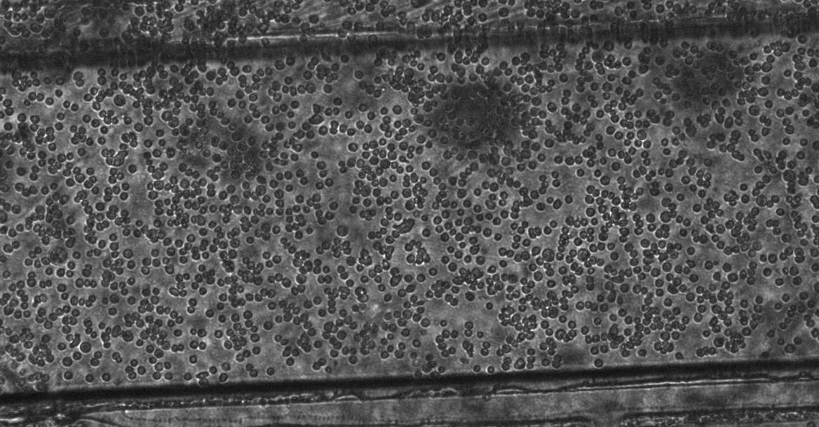
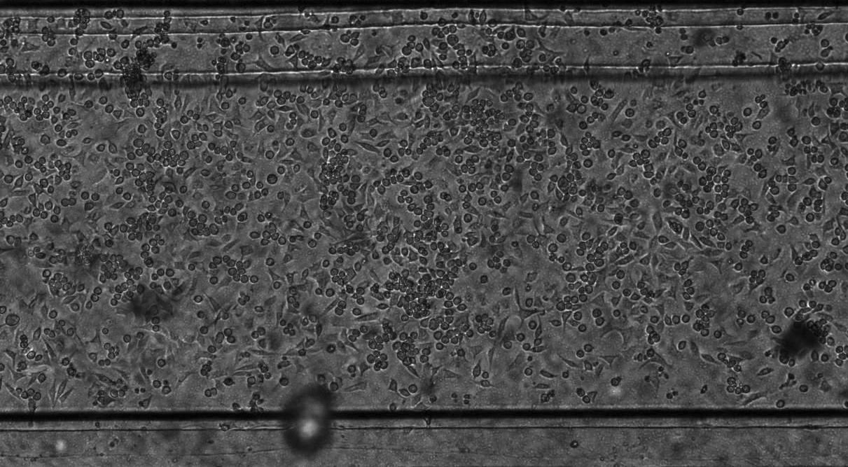
Results
Seeding
24 hours after seeding
Endothelial
Epithelial

Slide 8
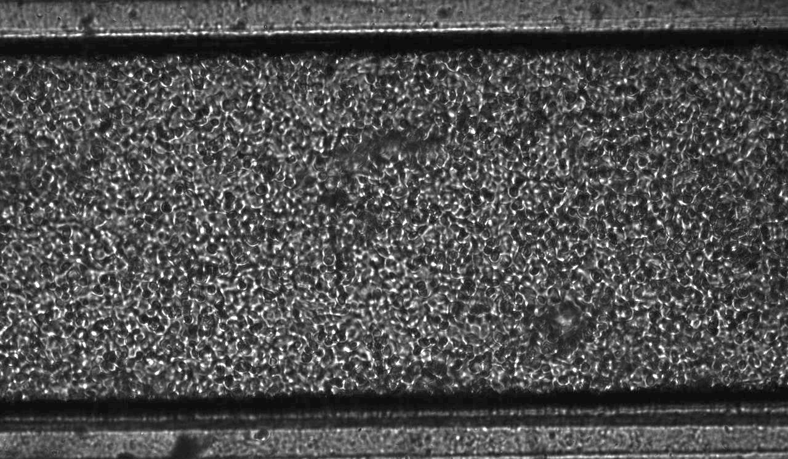
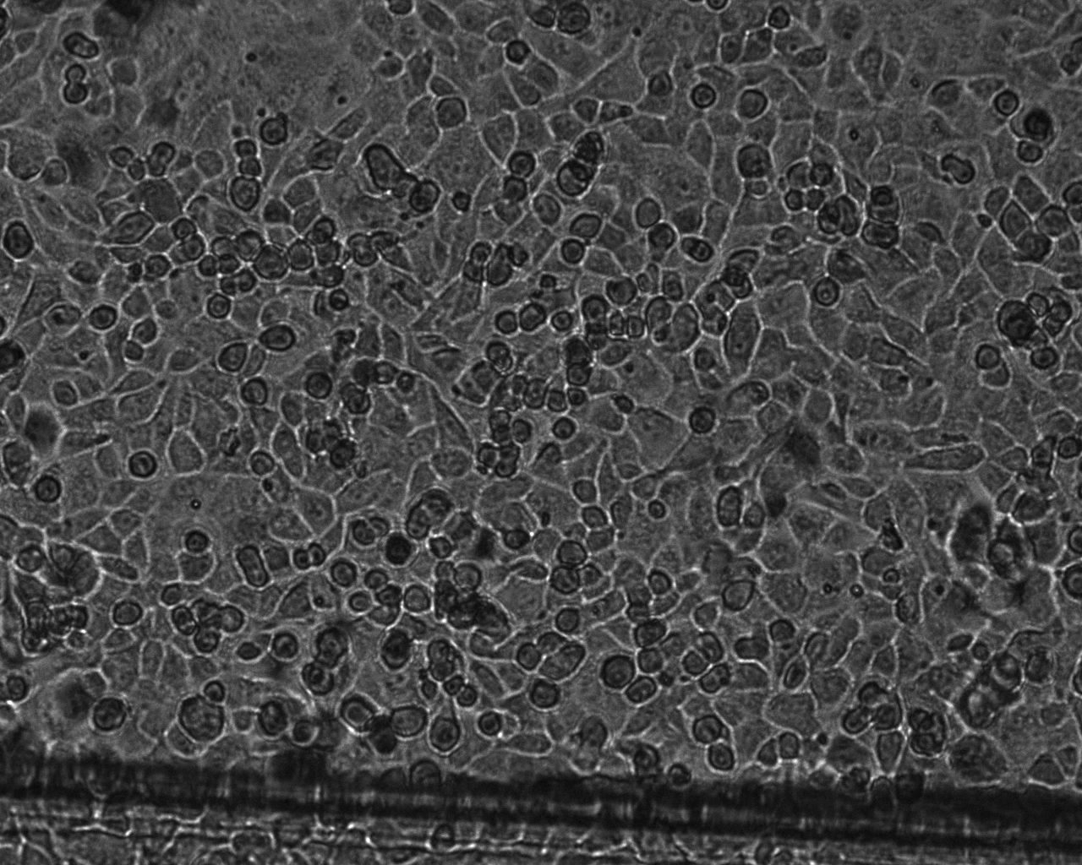
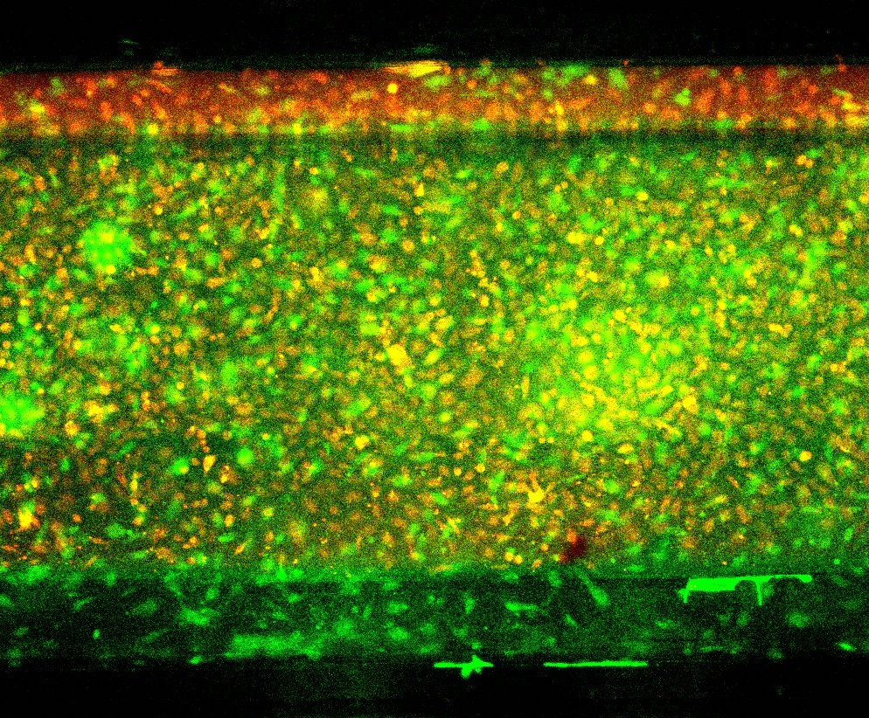
Results
Confluent cell layer- 4X
Confluent cell layer- 10X
Both layers- fluorescent stained

Slide 9
Significance of Results
Device is biocompatible
Cells remain viable and grow to confluence in device channel
Cells remain viable when in overlapping channels of same device

Slide 10
Acknowledgments
I would like to acknowledge and thank the
Arizona NASA Space Grant for funding,
and Drs. Linan Jiang and Yitshak Zohar for mentoring this project.

Slide 11
Thank You!

